Slide 1
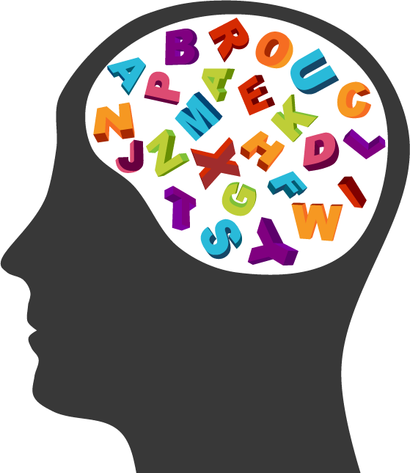
Facts and Fictions About Standardized Testing
2015-2016 Mathematics Education Team
Principal Investigator: Dr. Linda B Hayden
Mentor: Dr. Cheryl J Lewis
Members: Cameron Bernado, Jessica Hathaway, Joselyn Hathaway

Slide 2
Abstract
Criticism of standardized tests is nothing new [1]. Banesh Hoffman, professor of mathematics and former collaborator with Albert Einstein, made exactly this point in his 2003 book “The Tyranny of Testing”. Some standardize test have been found to be culturally bias, and have not necessarily been an accurate predictor of student success in undergraduate or graduate school.
Due to these concerns, testing companies, colleges/universities, and test-takers are seeking ways to level the playing field. As a result, several questions have been raised: 1) Is standardized testing really necessary and can these tests truly predict ones success in their academic career and/or profession? 2) What are the characteristics of people who do well or poorly on these tests? 3) Is there a magical formula to passing a standardized test? 4) Has research proved that certain test-taking strategies are more effective than others? 5) Are there campus/institution practices/interventions that can be used to successfully address problem areas and/or to close achievement gaps?
This group of researchers examined various test-taking techniques and tips, as a means to identify, select, and/or reject “common” test-prep endorsements that will aid to the enhancement of one’s success rate on test day. There has been a number of studies conducted that have been very effective in improving the test scores of individuals who are taking standardized testing (such as the SAT, ACT, PRAXIS, GMAT, and GRE).

Slide 3
Introduction
In the spring of 2016, the URE mathematics research team from the Center of Excellence in Remote Sensing Education and Research program at Elizabeth City State University, initially began its study by familiarizing themselves with the content area of various standardized test (such as the ACT, SAT, GMAT, GRE, and PRAXIS exams), followed by probing for what colleges/universities, local education agencies (LEAs), State Department of Instructions, other governmental agencies and employers may consider to be a passing/recommended test score for each of these exams. Still further, these researchers reviewed an array of sources to determine both pros and cons about standardized testing. Finally, this group searched for effective test-taking techniques and strategies to assist test takers in enhancing their standardized test scores.

Slide 4
Objectives
The purpose of this study is three-fold:
To define what is standardized testing and to identify facts & myths about standardized testing
To describe some of the factors that have been noted as factors that can influence standardized testing performance
To identify tips/strategies (if any) that can improve students’ performance on standardized tests

Slide 5
Research Questions
What is standardized testing?
Is standardized testing really necessary and can these test truly predict ones success in their academic career and/or profession?
What are the characteristics of people who do well or poorly on these tests?
Is there a magical formula to passing a standardized test?
Has research proved that certain test-taking strategies are more effective than others?
Are there campus/institution practices/interventions that can be used to successfully address problem areas and/or to clo achievement gaps?

Slide 6
What is standardized testing?
According to US Legal.com, standardized testing is a test administered and scored in a consistent or standard manner
A well designed standardized test provides an assessment of an individual’s mastery of a domain of knowledge or skill

Slide 7
The Necessity of Standardized Tests
Used to be evaluated for admissions into undergraduate, graduate, or professional programs
Easy way for some colleges/universities to weed out applicants
These tests are not accurate because:
The creator of the test assumes everyone thinks the same way when answering the questions
Graders fails to look at the test takers point of view aside from their own
Test takers may have test anxiety and cannot perform at their highest potential

Slide 8
Characteristics of Test-takers
Those who did well on standardized tests included:
Upper-class, white (European-American) students
Due to abundance of resources and the motivation to learn
Their environment and those surrounding them have an influence
Those who didn't’t do well on standardized tests included:
Lower-class, black (African-American) students
Lacked the funding or resources for materials needed for further learning
The environment included poor public school districts

Slide 9
Magical Formula
The question has been raised, are there secret ingredients used for passing standardized tests?
NO
There are tips and strategies that students can use to help them approach questions productively
There are free versions of standardized tests, which is the most effective
Study early
Understand how the test scored
Answer the easier questions first and go back if you have time
Get plenty of rest

Slide 10
Institutional Practices/Interventions
Bowie State University
PRAXIS Lab- increases awareness of issues in teaching
PLATO- web based interactive assessment and preparation for PRAXIS 1
Education course 220- 3 credit class that prepares students for the PRAXIS 1
Educational Testing Service- peer tutoring available at BSU’s library

Slide 11
Institutional Practices/Interventions (continued…)
Elizabeth City State University
Online Writing Lab (OWL)- available for all students; writing techniques are critiqued and perfected by English majors and professors
SAT workshops and senior seminars- available to students tear round
Vouchers- given to students that are not able to pay for the test themselves
Model Scholars- helps students, that scored low on the SAT, get into ECSU by taking summer courses for class credit

Slide 12
Institutional Practices/Interventions (continued…)
Delaware State University
Scholar Teacher Education Program (STEP Scholarship) covers tuition and fees (PRAXIS is not required)
Individualized Instructional Preparation in Education (EDUC 000)
Enhances reading, writing, math, speech, and test-taking strategies
2 credit hours
Similar to a GE course because it doesn’t fulfill degree requirements

Slide 13
Institutional Practices/Interventions (continued…)
Norfolk State University
Provide websites, YouTube videos, seminars, and courses to assist students with preparing for standardized tests
Encourage effective time management
Test Preparation Guide- designed to assist students in developing the competencies needed to reason
Also offers where and how to find sample test items

Slide 14
Methodology
Analysis of four HBCU Peer Institutions to see if the standardized testing facts and fiction were applicable
Data consisted of a list of variables:
Total student enrollment
Percentage of Pell Grant Recipients
Average combined SAT scores for incoming freshmen
Average GPA of incoming freshmen
Total # of incoming first time, full time freshmen
1st year retention rates, first time

Slide 15
Results
This chart displays the percentage of Pell Grant recipients for the four HBCU’s researched over a four-year period. ECSU has a 72% average for Pell Grant recipients; BSU’s Pell Grant recipient average was 50%. While DSU’s Pell Grant recipient’s average is 52%, NSU’s average is 64%. It was observed that ECSU’s percentage was the highest of the four HBCU’s and BSU’s percentage was the lowest.

Slide 16
Results (continued…)
This chart shows the results of SAT scores for the researched HBCU’s over a four-year period. ECSU’s average SAT score was 852 out of 2400 while BSU’s average was 862. DSU’s average was 955 and NSU’s average was 886.

Slide 17
Results (continued…)
This chart displays the results of first year retention rates from the four HBCU’s researched. ECSU has the highest retention rate, which was 76%. BSU and NSU have a common average of 71% and DSU has the lowest average of 65%.

Slide 18
Results (continued…)
Chi-Squared Retention Rates
Chi-Squared SAT Scores
This chi square was performed to see if SAT test scores have any impact on retention rates, because ETS finds that to be true. That statement is a myth because students with low SAT scores still have the potential to be successful.
Retention Rate Statistics
Statistic | DF | Value | Probability
Chi-Square | 12 | 2.2006 | 0.999
SAT Scores
Statistic | DF | Value | Probability
Chi-Square | 9 | 11.6252 | 0.2353

Slide 19
Future Work
Examine exemplary programs that have been proven to enhance standardized testing scores beginning with K-12 through graduate and professional school.
Investigate the success rates (test scores, promotion rates, retention rates, graduation rates) of students enrolled in these exemplary programs.
Determine whether there is any significant difference in the success rates of participants based on their gender, race, and socio-economic status.

Slide 20
Acknowledgements
Dr. Linda B. Hayden who has provided the funding for this research project
Dr. Cheryl J. Lewis for her guidance, input, and support throughout the duration of this project
Dr. Patterson for technical assistance and support
Mr. Brian Jordan, Program Specialist, Office of Institutional Effectiveness, Research, and Assessment for his assistance in our statistical data analysis
Dr. Sheila H. Williams, Director of Teacher Education & School Partnership for her candidness regarding the pros & pitfalls of Test-takers of the PRAXIS exam at Elizabeth City State University and other HBCU’s

Slide 21
References
B. Hoffmann, The Tyranny of Testing. Mineola, N.Y.: Dover Publications, 2003.
Standardized Test Education Law & Legal Definition,definitions.uslegal.com/s/.standardized-test-education/, March 15, 2016.
C. Carter, Case Against Standardized Tests (1999), Testshttp://testcritic.homestead.com./standardizedtesting/. Accessed: March 1, 2016.
L. Sheu, S. Dada, Impact of Household Income on Standardized Test Scores, Georgia Institute of Technology, smartech.gatech.edu, http://hdt. handle.net/1853/54227, p. 1-19, November 2015. [Accessed February 23, 2016].

Slide 22
References (continued…)
"8 Tips to Help You Pass a Standardized Test", GetCollegeCredit, 2014.
B. Lewolt, "Brain Research on Test Taking Strategies: There is no such thing as a naturally bad test taker – True!”, Brainx.com, http://www.brainx.com/resources /blog/bid/51477/Brain-Research-on-Test-Taking-Strategies-There-is-no-such-thing-as-a-naturally-bad-test-taker-True. [Accessed: 29- Mar-2016].
Kruger and D. Wirtz, "Counterfactual Thinking and the First Instinct Fallacy", Journal of Personality and Social Psychology, pp. 1-40, 2016.

Slide 23
Questions?

